Slide 1

Genome Rearrangements
Tseng Chiu Ting
Sept. 24, 2004

Slide 2
Genome Rearrangements Distance by Fusion, Fission, and Transposition is Easy
Joao Meidanis, Zanoni Dias
Proceedings of SPIRE'2001

Slide 3
Operation
α(x)=y means x moves to y.
αβ(x)=α (β(x)) for all x
Ex1: α =(2 3 4), β=(3 1 5 2 6 4), then
αβ=(1 5 3)(2 6)
Ex2: α =(7 3 2), β=(7 1 5 3 2 6 4), then
αβ=(7 1 5 2 6 4 3)

Slide 4
Operation
α =(x y), if x and y are in different cycle of β, then αβ is a fusion, else αβ is a fission.
Ex1: α=(2 3), β=(1 5 3)(2 6), then αβ=(1 5 2 6 3) fusion
Ex2: α=(2 3), β=(1 5 2 6 3), then αβ=(1 5 3) (2 6) fission

Slide 5
Results
Given two distinct permutations(genomes) π and σ, there is always a good event for π with respect to σ.
Given two permutations(genomes) π and σ, the distance between them is n-c(π, σ), c(π, σ) denotes the number of orbits of σπ⁻¹.

Slide 6
Sorting by Transpositions
SIAM J. Discrete Math, vol. 11, No. 2, pp. 224-240, 1998
V. Bafna, P. V. Pevzner

Slide 7

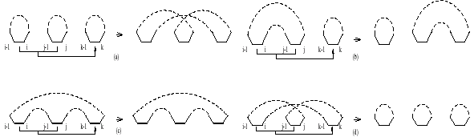
Method

Slide 8
Method
Identity permutation (1 2 3 … n) has n cycles, all are odd cycle.
Algorithm TransSort(π)
1. While G(π) has a long cycle, perform a valid 2-move or a valid 0, 2, 2-move.
2. If G(π) has only short cycles, perform a good 0-move followed by a valid 2-move

Slide 9
Result
Algorithm TransSort sorts permutation in no more than 0.75 (n + 1 – C_{odd}(π)) transpositions, thereby ensuring a performance guarantee of 1.5.

Slide 10
A Simpler 1.5-Approximation algorithm for Sorting by Transpositions
T. Hartman, R. Shamir
CPM2003, pp. 156-169

Slide 11
Linear & Circular Perms
A transposition “cuts” the perm at 3 points.
Linear transposition :
t
A
B
C
D
A
C
B
D
Circular transposition :
A
A
t
B
C
C
B
Circular transpositions can be represented by exchanging any 2 of the 3 segments.

Slide 12
The Algorithm
While G contains a 2-cycle, apply a
2-transposition [Christie99].
If G contains an oriented 3-cycle, apply a 2-transposition on it.
If G contains a pair of interleaving 3-cycles, apply a (0,2,2)-sequence.
If G contains a shattered unoriented 3-cycle, apply a (0,2,2)-sequence.
Repeat until perm is sorted.

Slide 13
3 - Cycles
2 possible configurations of 3-cycles:
Non-oriented 3-cycle
Oriented 3-cycle

Slide 14
Interleaving Cycles
2 cycles interleave if their black edges appear alternatively along the circle.
Lemma : If G contains 2 interleaving 3-cycles, then ∃ a (0,2,2)-sequence.

Slide 15
Shattered Cycles
2 pairs of black edges intersect if they appear alternatively along the circle.
Cycle A is shattered by cycles B and C if every pair of black edges in A intersects with a pair in B or with a pair in C.
Lemma : If G contains a shattered cycle, then ∃ a (0,2,2)-sequence.

Slide 16
A Simpler and Faster 1.5-Approximation Algorithm for Sorting by Transpositions
T. Hartman
Jan 14,2004

Slide 17
Exact and Approximation Algorithms for Sorting by Reversals, with Application to Genome Rearrangement
John Kececioglu, David Sankoff
Algorithmica, vol. 13, pp.180- 210, 1995

Slide 18
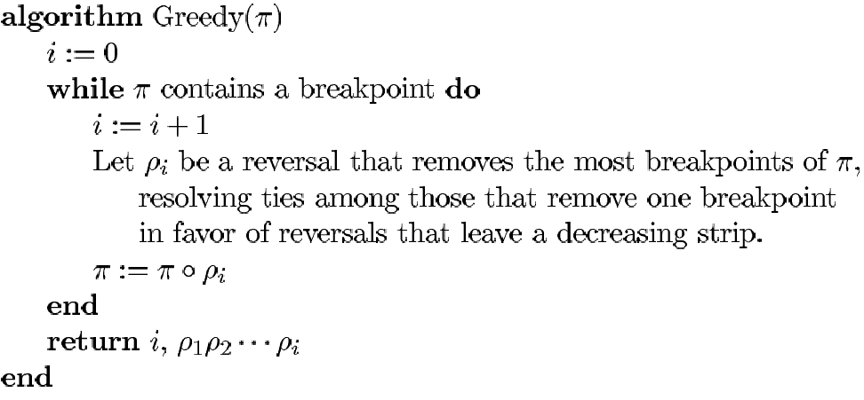
Method

Slide 19
Results
Lemma 1: Every permutation with a decreasing strip has a reversal that removes a breakpoint.
1 2 4
…
11 8 7 5
1 2 4
5 7 8 11
…
11 8 7 5
…
1 2 4
11 8 7 5
4 2 1
…

Slide 20
Results
Every Reversal can decrease at most two breakpoints.
Opt(π)≧0.5Φ(π) ≧0.5App(π)
1 2 4
11 8 7 5
12 13 14

Slide 21
Transforming Cabbage into Turnip: Polynomial Algorithm for Sorting Signed Permutations by Reversals
1. In Proc. 27th Annual ACM symposium on the Throry of Computing, pp. 178-189, 1995
2. J. ACM, Vol. 46, No. 1, pp. 1-27, 1999
S. Hannenhalli, P. A. Pevzner

Slide 22
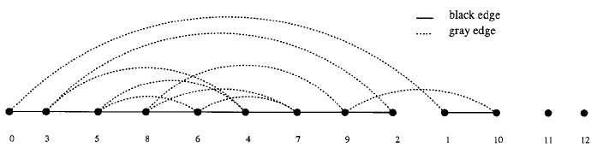
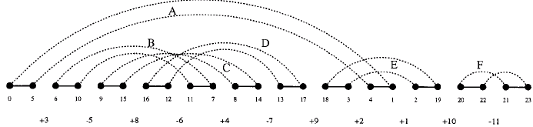
Breakpoint graph

Slide 23

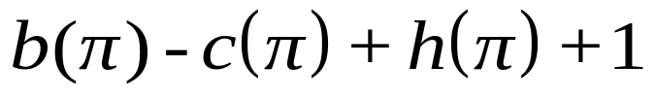

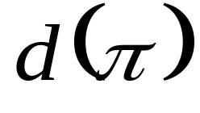
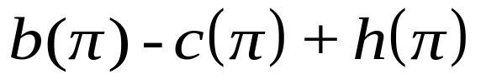
Reversal Distance
is a
fortress
if
=
otherwise
b: breakpoint
c: cycle
h: hurdle
O(n²)

Slide 24
Fortress
A permutation π is called a fortress if it has odd number of hurdles and all of these hurdles are superhurdles.

Slide 25
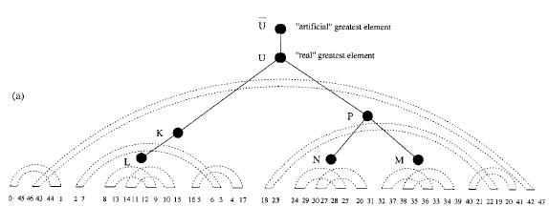
Hurdle and Superhurdle

Slide 26
Polynomial Algorithm
1. while π is not sorted
2. if π has a long cycle
3. select a safe ( g, b)-padding ρ of π
4. else if π has an oriented component
5. select a safe reversal ρ in this component
6. else if π has an even number of hurdles
7. select a safe reversal ρ merging two hurdles in π
8. else if π has at least one simple hurdle
9. select a safe reversal ρ cutting this hurdle in π
10. else if π is a fortress with more than three superhurdles
11. select a safe reversal r merging two (super)hurdles in π
12. else /* π is a 3-fortress */
13. select an (un)safe reversal r merging two arbitrary (super)hurdles in p
14. π = ρ π
15. endwhile
16. mimic (genuine) sorting of π using the computed generalized sorting of π
O(n⁴)

Slide 27
Simple Polynomial Algorithm
while π is not sorted
select a valid reversal ρ in π
π = ρπ
endwhile
O(n⁵)

Slide 28
Fast Sorting by Reversal
CPM 1996, pp.168-185
P. Berman, S. Hannenhalli

Slide 29
Improvement
Finding connected component in O(nα(n)) time.
Finding safe reversal in O((nα(n)) time.
Implementation of Reversal_Sort in O(n²α(n)).

Slide 30
A Faster and Simpler Algorithm for Sorting Signed Permutation by Reversals
SIAM Journal on Computing, Vol. 29, No. 3, 2000, pp. 880-892
H. Kaplan, R. Shamir and R. E. Tarjan

